Slide 1
Plant Sciences
Biology-the branch of science that deals with both plant and animal organisms and life processes
  Zoology-the part of biology that deals with animals
  Botany the part of biology that deals with plants

Slide 2

Plant Sciences
Applied plant sciences are based on the purposes for which the plants are grown
  Agronomy
  Forestry
  Horticulture

Slide 3
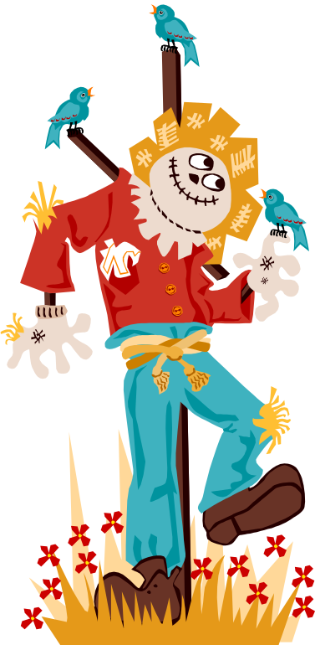
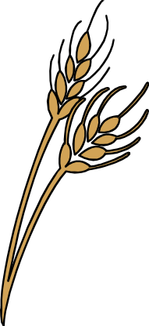
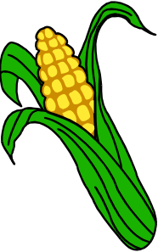
Agronomy
The science and practice of growing field crops such as cotton, wheat, tobacco, corn and soybeans.

Slide 4
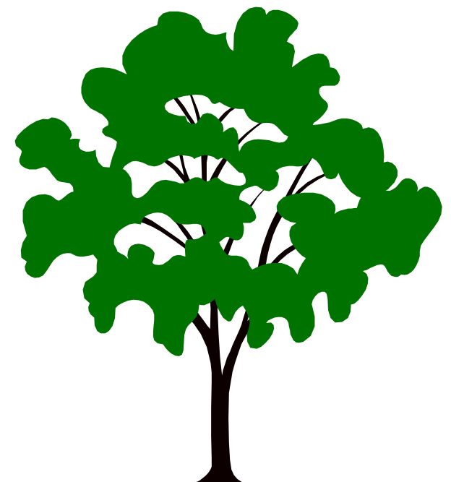
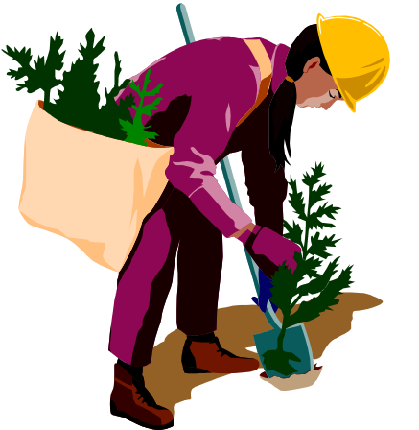
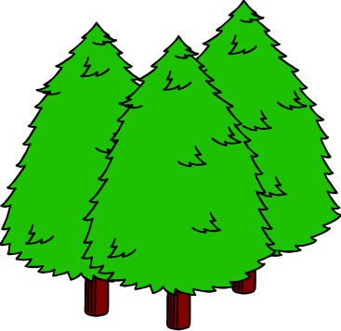
Forestry
The science and practice of growing, managing and harvesting trees for building materials and other products.

Slide 5

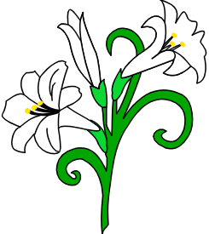

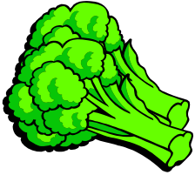

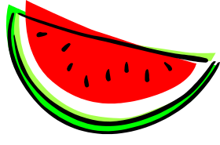
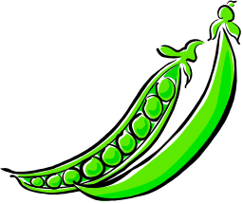
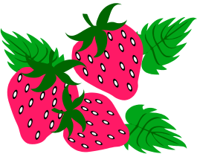
Horticulture
The science and practice of growing, processing and marketing fruits, vegetables, and ornamental plants

